Slide 1

Spring Framework

Slide 2
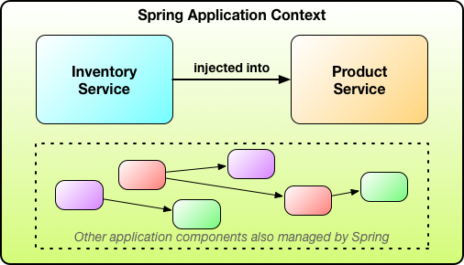
1. Core Spring: Introduction

Slide 3
Simplifying Java Development
Spring employs four key strategies:
Lightweight and minimally invasive development with POJOs
Loose coupling through DI and interface orientation
Declarative programming through aspects and common conventions
Eliminating boilerplate code with aspects and templates

Slide 4
Injecting dependencies

Slide 5
Injecting dependencies

Slide 6
Injecting dependencies

Slide 7
Injecting dependencies

Slide 8
Introduction to AOP

Slide 9
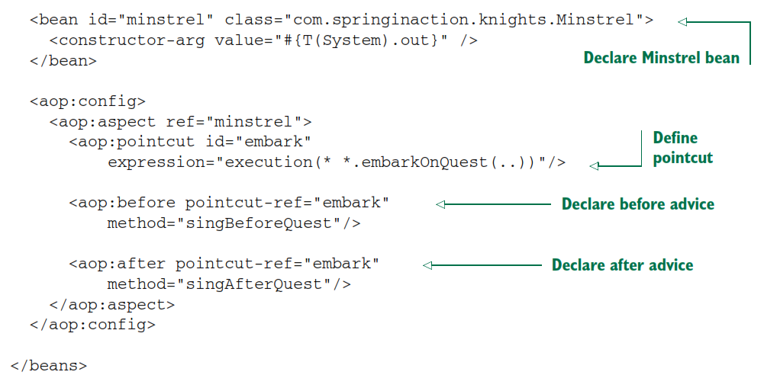
Introduction to AOP

Slide 10
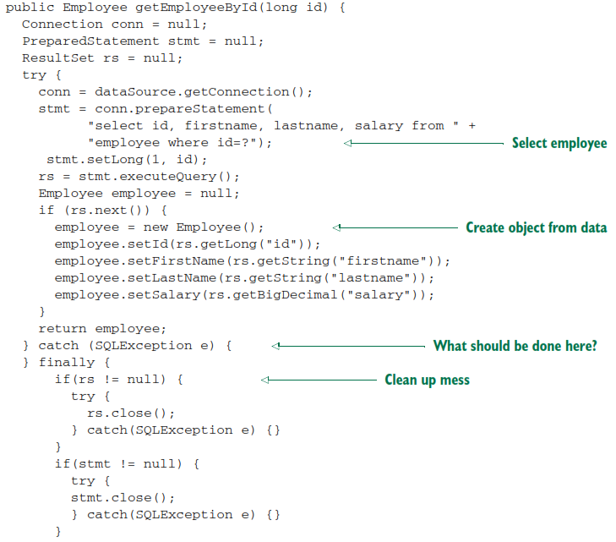
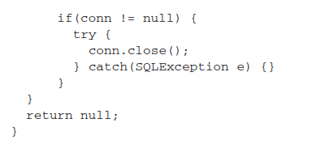
Eliminating boilerplate code with templates

Slide 11
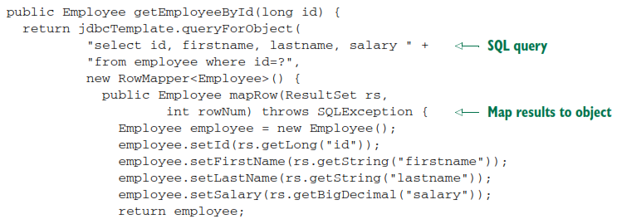

Eliminating boilerplate code with templates
Templates let your code focus on the task at hand:

Slide 12
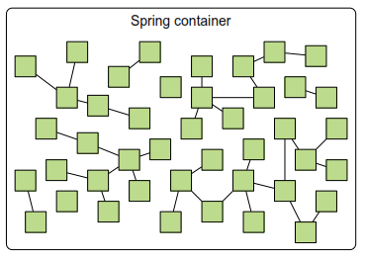
Containing your beans
In a Spring application, objects are created, are wired together, and live in the Spring container.
Spring comes with several container implementations that can be categorized into two
distinct types:
Bean factories (defined by the org.springframework.beans.factory.BeanFactory interface) are the simplest of containers, providing basic support for DI.
Application contexts (defined by the org.springframework.context.ApplicationContext interface) build on the notion of a bean factory by providing application-framework services

Slide 13
Spring Application context
AnnotationConfigApplicationContext—Loads a Spring application context from one or more Java-based configuration classes
AnnotationConfigWebApplicationContext—Loads a Spring web application context from one or more Java-based configuration classes
ClassPathXmlApplicationContext—Loads a context definition from one or more XML files located in the classpath, treating context-definition files as classpath resources
FileSystemXmlApplicationContext—Loads a context definition from one or more XML files in the filesystem
XmlWebApplicationContext—Loads context definitions from one or more XML files contained in a web application

Slide 14
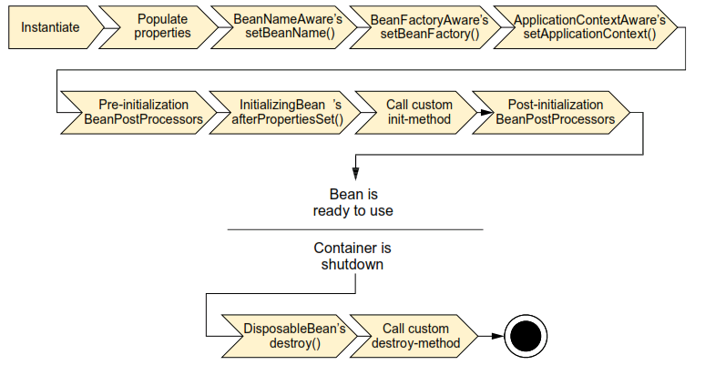
A bean's life
A bean goes through several steps between creation and destruction in the Spring container. Each step is an opportunity to customize how the bean is managed in Spring.

Slide 15
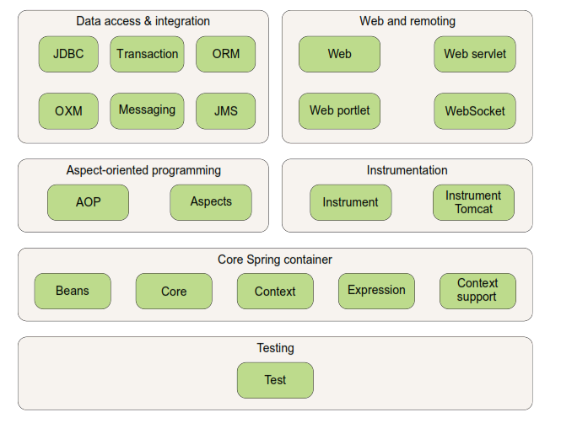
Spring modules
The Spring Framework is made up of six well-defined module categories.

Slide 16
The Spring portfolio
Spring Web Flow - Spring‘s core MVC Framework to provide support for building conversational, flow-based web applications
Spring Web Services - Spring Web Services offers a contract-first web services model where service implementations are written to satisfy the service contract (In Spring Core you can generate Webservice from Bean’s Interface – contract-last)
Spring Security - Implemented using Spring AOP
Spring Integration - Spring Integration offers implementations of several common integration patterns in Spring’s declarative style.
Spring Batch, Spring Data (all kinds of databases, also NonSQL), Spring Social (Facebook, Twitter etc. via REST API), Spring Mobile (Extension to Spring MVC), Spring for Android, Spring Boot

Slide 17
Wiring beans
Spring‘s configuration options
Explicit configuration in XML
Explicit configuration in Java
Implicit bean discovery and automatic wiring
Component scanning—Spring automatically discovers beans to be created in the application context.
Autowiring—Spring automatically satisfies bean dependencies.

Slide 18
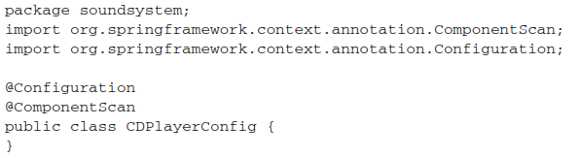
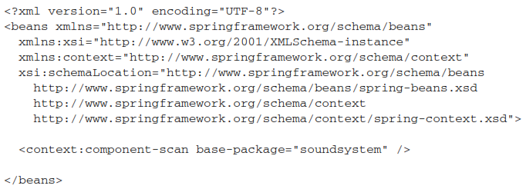
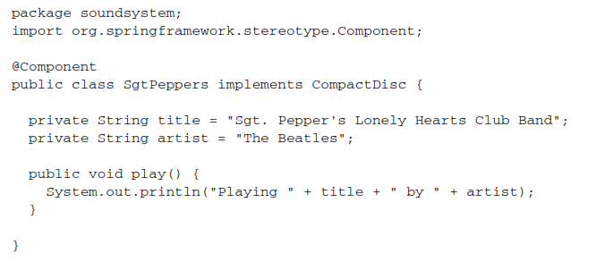
Creating discoverable beans
To enable component scanning, you can
define a configuration class without any bean with @Configuration and @ComponentScan annotation in the same package as the beans
You can use a XML configuration
@Component SgtPeppers is a bean to be discovered

Slide 19
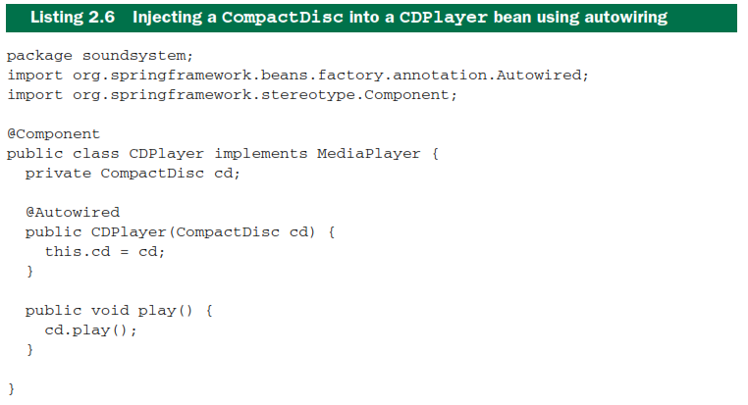
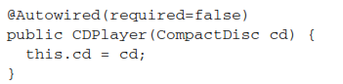
Annotating beans to be automatically wired
@Autowired: Whether it’s a constructor, a setter method, or any other method, Spring will attempt to satisfy the dependency expressed in the method’s parameters. Assuming that one and only one bean matches, that bean will be wired in. If there are no matching beans, Spring will throw an exception as the application context is being created. To avoid that exception, you can set the required attribute
on @Autowired to false:

Slide 20
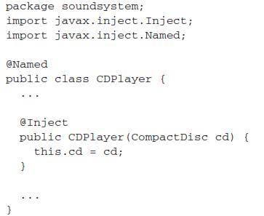
Annotating beans to be automatically wired
@Autowired is a Spring-specific annotation. If it troubles you to be scattering Spring-specific annotations throughout your code for autowiring, you might consider using the @Inject annotation instead:
@Inject comes from the Java Dependency Injection specification
Although there are some subtle differences between @Inject and @Autowired, they are interchangeable in many cases.

Slide 21
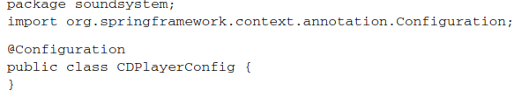
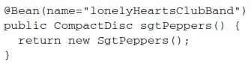
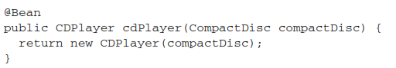
Wiring beans with Java
Creating a configuration Class
Declaring a simple Bean
Injecting with JavaConfig

Slide 22
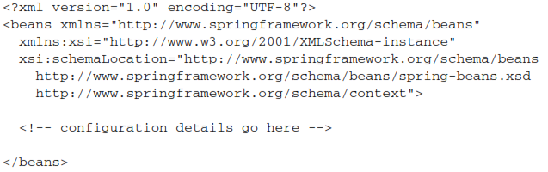
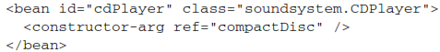
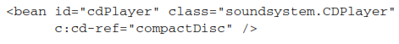
Wiring beans with XML
Creating an XML configuration specification (use Spring Tool Suite)
Declaring a simple <bean> (no need for naming the bean)
Initializing a bean with constructor injection with <constructor-arg> element or c-namespace

Slide 23
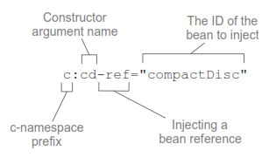
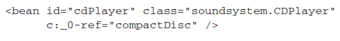
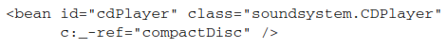
Initializing a bean with constructor injection (cont.)
Injecting a bean reference into a constructor argument with Spring‘s c-namespace
You can refer the constructor argument name, position in the argument list or if you have only one argument, you don‘t need to specify it at all:

Slide 24
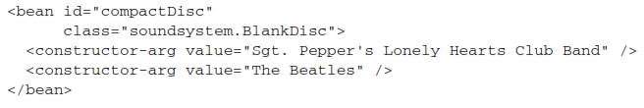
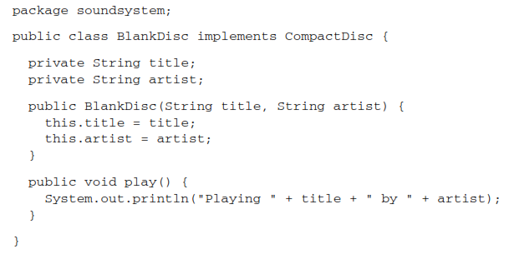
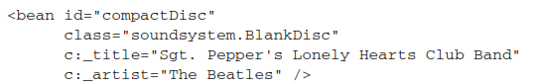
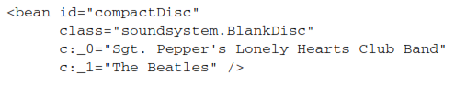
Injecting constructor with literal values

Slide 25
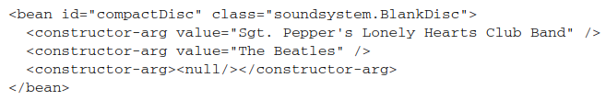
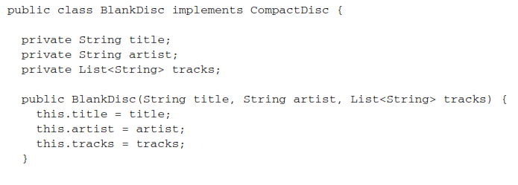
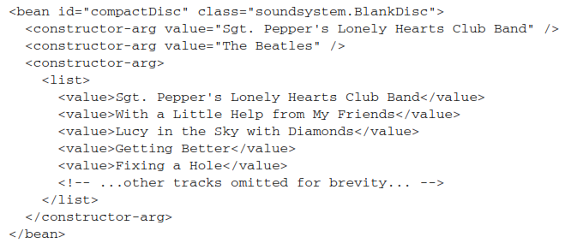
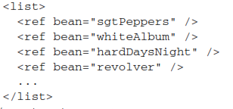
Wiring Collections
null or a list

Slide 26
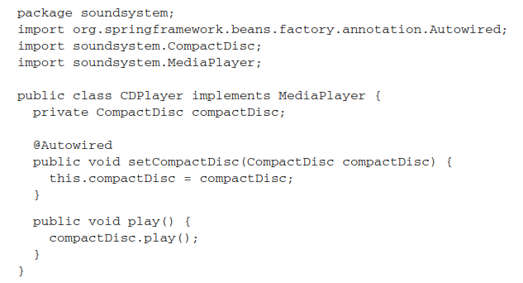
Setting properties
Constructor injection for hard dependencies
Property injection for optional dependencies

Slide 27
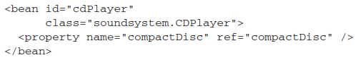
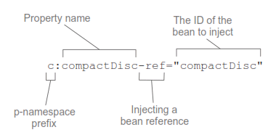
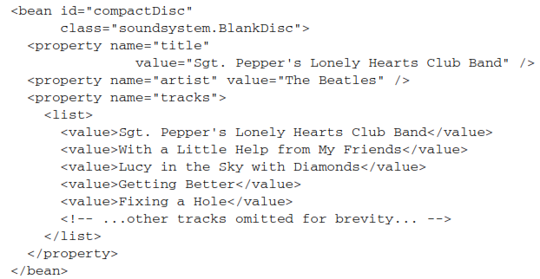
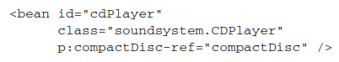
Wiring Properties
Using <property> element
Using p-namespace (you have to declare
p-namespace in XML file bevor use)
injecting literal values
p:property-name without „ref“
There is no no convenient way to specify
a list of values with the p-namespace

Slide 28
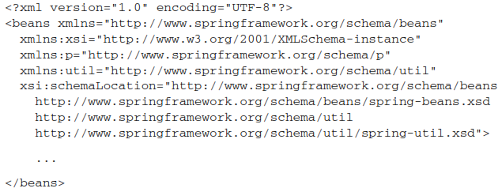
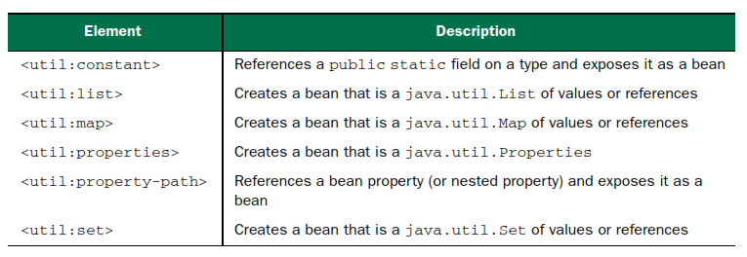
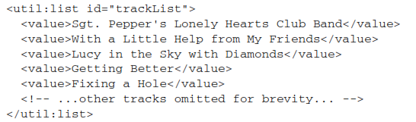
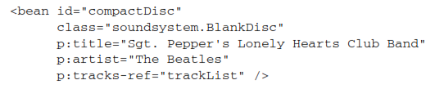
Spring util-namespace

Slide 29
Importing and mixing configurations
You are free to mix component scanning and autowiring with JavaConfig and/or XML configuration
Autowiring considers all beans in the Spring container, regardless of whether they were declared in JavaConfig or XML or picked up by component scanning

Slide 30
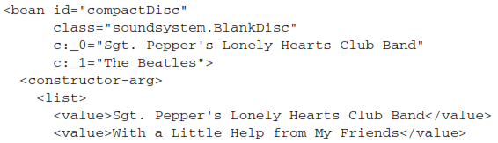
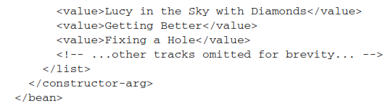
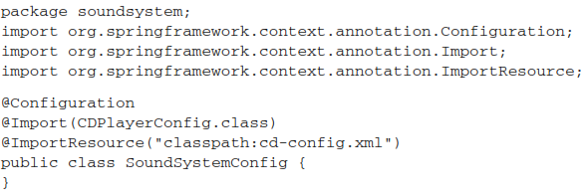
Referencing XML configuration in JavaConfig

Slide 31
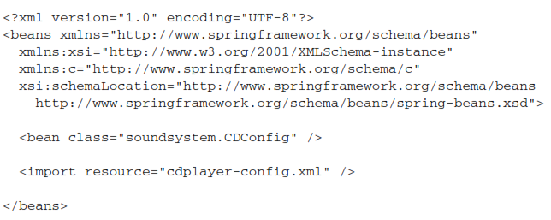
Referencing JavaConfig in XML configuration

Slide 32
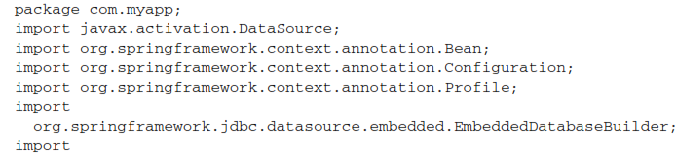
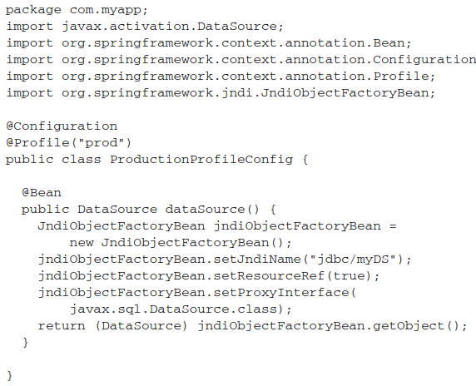
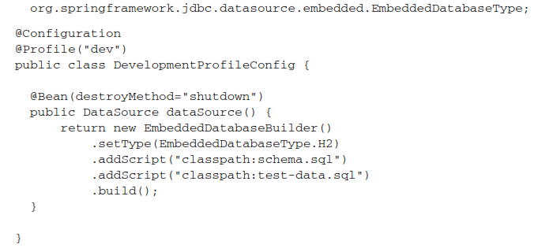
Advanced Wiring: Environments and profiles
In Java configuration, you can use the @Profile annotation to specify which profile a bean belongs to
@Profile annotation applied at the class level: It tells Spring that the beans in this configuration class should be created only if the dev profile is active. If the dev profile isn’t active, then the @Bean methods will be ignored.

Slide 33
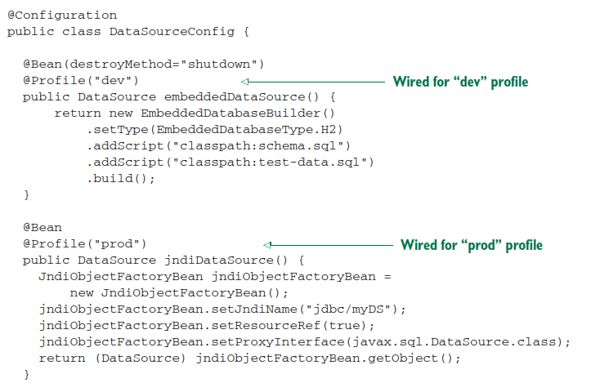
Advanced Wiring: Environments and profiles
In Spring 3.1, you could only use the @Profile annotation at the class level. Starting with Spring 3.2, you can use @Profile at the method level, alongside the @Bean annotation. This makes it possible to combine both bean declarations into a single configuration class

Slide 34
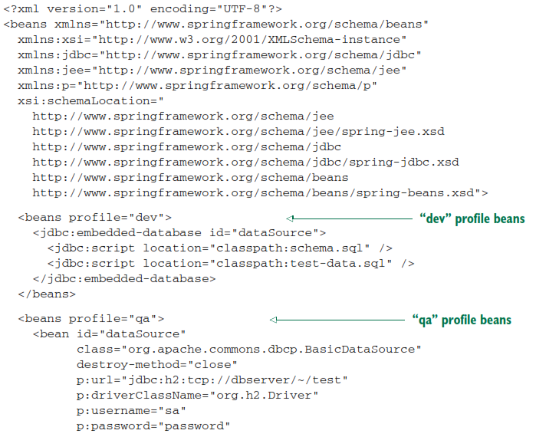
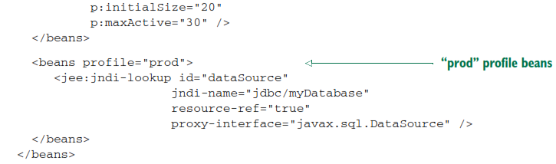
Advanced Wiring: Environments and profiles
Configuring profiles in XML

Slide 35
Activating profiles
Spring honors two separate properties when determining which profiles are active:
spring.profiles.active and spring.profiles.default.
If spring.profiles.active is set, then its value determines which profiles are active. But if spring.profiles.active isn’t set, then Spring looks to spring.profiles.default. If neither spring.profiles.active nor spring.profiles.default is set, then there are no active profiles, and only those beans that aren’t defined as being in a profile are created.

Slide 36
Activating profiles
There are several ways to set these properties:
As initialization parameters on DispatcherServlet
As context parameters of a web application
As JNDI entries
As environment variables
As JVM system properties
Using the @ActiveProfiles annotation on an integration test class

Slide 37




Setting default profiles in a web application뭩 web.xml file

Slide 38

Testing with profiles
Spring offers the @ActiveProfiles annotation to let you specify which profile(s) should be active when a test is run.

Slide 39


Conditional beans
E.g. if you want beans to be configured only if some libraries are in the classpath or some environment variables are set
Spring 4 introduces @Conditional annotation – only if the condition is true the bean will be created

Slide 40

Conditional beans

Slide 41

Conditional beans
The matches() method is given a ConditionContext and an AnnotatedTypeMetadata to
use in making its decision:
From the ConditionContext, you can do the following:
Check for bean definitions via the BeanDefinitionRegistry returned from getRegistry().
Check for the presence of beans, and even dig into bean properties via the ConfigurableListableBeanFactory returned from getBeanFactory().
Check for the presence and values of environment variables via the Environment retrieved from getEnvironment().
Read and inspect the contents of resources loaded via the ResourceLoader returned from getResourceLoader().
Load and check for the presence of classes via the ClassLoader returned from getClassLoader().

Slide 42


Profile Condition
As for the AnnotatedTypeMetadata given to the Condition Interface, it offers you a chance to inspect annotations that may also be placed on the @Bean method. Like ConditionContext, AnnotatedTypeMetadata is an interface.
Check if profile is active

Slide 43




Addressing ambiguity in autowiring

Slide 44


Addressing ambiguity in autowiring
Designating a primary bean – perfect as long you define only one @Primary bean

Slide 45





Addressing ambiguity in autowiring
Using Qualifier – it is not allowed in Java to use more annotations of the same type on the same element
Defining custom Qualifier:

Slide 46
Scoping beans
Spring defines several scopes under which a bean can be created, including the following:
Singleton - One instance of the bean is created for the entire application.
Prototype - One instance of the bean is created every time the bean is injected into or retrieved from the Spring application context.
Session - In a web application, one instance of the bean is created for each session.
Request - In a web application, one instance of the bean is created for each request.

Slide 47




Working with request and session scope
Singleton StoreService needs a shopping card bean
but this is session scoped – created with every new user
Creating a proxy:

Slide 48


Runtime value injection
to avoid hard-coded values and to let the values be determined at runtime
Using the @PropertySource annotation and Environment

Slide 49



Spring Environment

Slide 50



Resolving property placeholder
Using external properties-file you can define values without hardcoding in XML files or using @Value annotation
In order to use placeholder values, you must configure either a PropertyPlaceholderConfigurer bean or a PropertySourcesPlaceholderConfigurer bean.

Slide 51

Wiring with the Spring Expression Language
An example:
The T() operator evaluates java.lang.System as a type so that
the staticcurrentTimeMillis() method can be invoked.

Slide 52



Some SpEL examples
Safe against NullPointerException
Regular Expressions

Slide 53

SpEL examples - Collections
Fourth character – „s“
„.?[]“ Filter a subarray from an array
„.^[]“ first matching entry and „.$[]“ last matching entry
.![] maps an array of songs objects to an array of strings - titles
Returns an array of titles of all songs from Aerosmith

Slide 54

Aspect-oriented Spring
Crosscutting concerns can now be modularized
into special classes called aspects.
Benefits:
the logic for each concern is in one place,
as opposed to being scattered all over the code base.
Your service modules are cleaner because they
only contain code for their primary concern

Slide 55


Defining AOP terminology

Slide 56
Defining AOP terminology
Join points: a point in the execution of the application where an aspect can be plugged in. This point could be a method being called, an exception being thrown, or even a field being modified.
Pointcuts: an aspect doesn’t necessarily advise all join points in an application. Pointcuts help narrow down the join points advised by an aspect. you specify these pointcuts using explicit class and method names or through regular expressions that define matching class and method name patterns.
Aspect: an aspect is the merger of advice and pointcuts.
Introduction: an introduction allows you to add new methods or attributes to existing classes.

Slide 57

Defining AOP terminology (cont.)
Weawing: the process of applying aspects to a target object to create a new proxied object. The aspects are woven into the target object at the specified join points. The weaving can take place at several points in the target object’s lifetime:

Slide 58
Spring‘s AOP support
Spring’s support for AOP comes in four styles:
Classic Spring proxy-based AOP - overcomplicated
Pure-POJO aspects - With Spring’s aop namespace, you can turn pure POJOs into aspects. They are called in reaction to a pointcut. Unfortunately, this technique requires XML configuration, but it’s an easy way to declaratively turn any object into an aspect.
@AspectJ annotation-driven aspects
Injected AspectJ aspects (available in all versions of Spring)
Spring AOP is built around dynamic proxies. Consequently, Spring’s AOP support is limited to method interception.
If your AOP needs exceed simple method interception (constructor or property interception, for example), you’ll want to consider implementing aspects in AspectJ. In that case, the fourth style listed will enable you to inject values into AspectJ-driven aspects

Slide 59

Selecting join points with pointcuts
SPRING ADVISES OBJECTS AT RUNTIME
SPRING ONLY SUPPORTS METHOD JOIN POINTS

Slide 60

Selecting join points with pointcuts
In Spring AOP, pointcuts are defined using AspectJ’s pointcut expression language

Slide 61


Writing pointcuts

Slide 62

Writing pointcuts (cont.)

Slide 63


Selecting beans in pointcuts

Slide 64


Creating annotated aspects

Slide 65

Spring annotation to advice declaration

Slide 66

Creating annotated aspects (cont.)

Slide 67

Enabling auto-proxing in JavaConfig

Slide 68

Enabling auto-proxing in XML

Slide 69


Creating around advice

Slide 70

Handling parameters in advice

Slide 71

Handling parameters in advice

Slide 72

Creating annotated aspects

Slide 73

Annotating introductions

Slide 74

Annotating introductions

Slide 75

Annotating introductions

Slide 76

Annotating introductions

Slide 77

Annotating introductions

Slide 78


Declaring aspects in XML

Slide 79

Declaring aspects in XML

Slide 80

Declaring before and after advice

Slide 81


Declaring around advice

Slide 82

Passing parameters to advice

Slide 83

Passing parameters to advice

Slide 84

Introducing new functionality with aspects

